Slide 1




Market study on the distribution of
hotel accommodation in the EU
Meeting with stakeholders
LOGO

Slide 2
Agenda
Study objective & geographical scope
Sample of economic operators
Methodology
Workplan and next steps

Slide 3
Study scope, objective
& country coverage

Slide 4



Study scope, objective & country coverage
The objective of the study is to provide up-to-date facts on the distribution of hotel accommodation in the EU, including on any changes that have occurred since the ECN Monitoring Exercise of 2016, and any changes resulting from national laws prohibiting the use of parity clauses by hotel booking platforms.
The study covers the period from January 2017 to March 2021 inclusive
The study covers the following Member States: Austria, Belgium, Cyprus, Poland, Spain and Sweden

Slide 5
Research questions
How is hotel accommodation distributed in the Member States covered by the study?
Do distribution arrangements differ between these Member States? If so, what are the reasons for such differences?
Have distribution arrangements changed relative to the situation described in the report on the ECN Monitoring Exercise for the period July 2015 to June 2016? If so, what are the reasons for such changes?
Has the adoption of laws banning hotel booking platform parity clauses led to changes in distribution arrangements in the Member States concerned?

Slide 6
Sample of
economic operators

Slide 7
Independent hotels & chains
Independent hotels
Sample of 300 independent hotels for each of the six Member States (25 for Cyprus)
The sample shall be representative of the general population of independent hotels, in terms of size (number of rooms), star rating and use of hotel booking platforms.
Hotel chains
Sample of 20 hotel chains
Each chain shall have operations in at least one of the six Member States and the sample shall include a variety of business models

Slide 8
OTAs and metasearch / PCWs
Sample of minimum ten OTAs (including five undertakings whose websites list the highest number of hotels located in the EU)
Each undertaking should list hotels in a minimum of three of the six MS in scope
A similar approached for the metasearch / PCWs to identify minimum ten undertakings (including five undertakings whose websites list the highest number of hotels located in the EU). Same as for OTAs, each undertaking should list hotels in a minimum of three of the six MS in scope

Slide 9
Methodology

Slide 10
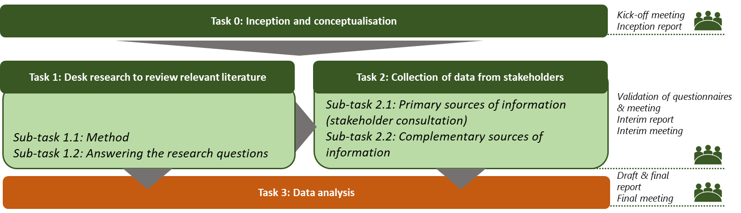
Overall approach

Slide 11
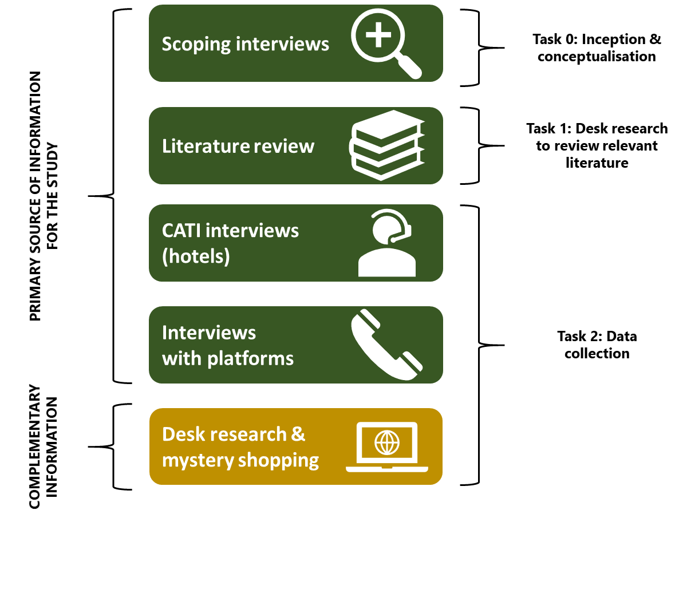
Research toolbox
Given the length of the interview guide and the amount of data required, we will ask for written answers and organise follow-up interviews (in-depth or CATI) for clarifications / filling data gaps

Slide 12
32 Indicators
the share of hotel accommodation sold offline
the share of hotel accommodation sold online
the share of hotel accommodation sold direct
the share of hotel accommodation sold indirect
hotels’ use of booking platforms, including their homing and switching behaviour
the relative size of the booking platforms (e.g. overall revenues, traffic share, consumer preferences)
size of the booking platforms: hotel-related revenue
size of the booking platforms: their hotel booking volumes
size of the booking platforms: the number of hotels they list
the rates of commission (basic and effective)
other fees and charges levied by the hotel booking platforms
room price differentiation by hotels between sales channels (between direct and indirect sales channels and between hotel booking platforms)
room availability differentiation by hotels between sales channels (between direct and indirect sales channels and between hotel booking platforms)
hotel booking platform conversion rates (look-to-book ratios)
the use of metasearch websites by hotel booking platforms, including the payment models of such websites
the use of metasearch websites by hotels, including the payment models of such websites
the use of online advertising by hotels, including search engine advertising
the use of online advertising by hotel booking platforms, including search engine advertising
the use of online advertising by metasearch operators, including search engine advertising
hotels’ use of bed wholesalers/bed banks
the relationships between bed wholesalers/bed banks and hotel booking platforms and metasearch operators
the relative cost of sales channels for hotels
the parity clauses used by hotel booking platforms
enforcement of and compliance with hotel booking platform parity clauses
the use of other measures by hotel booking platforms to incentivise hotels to offer them favourable room prices and inventory, including measures relating to visibility and ranking
the use of performance/parity scoring by hotel booking platforms in their relationships with hotels
the use of consumer best price guarantees by hotel booking platforms and hotels
the use of loyalty schemes by hotels and hotel booking platforms
commission sharing and room price discounting by hotel booking platforms
the use of other consumer-facing and hotel-facing commercial strategies by hotel booking platforms
evidence of recent or expected entry or expansion by platforms offering price comparison or booking services for hotel or other short-term accommodation, including Google and Airbnb
Consumers’ journey and their booking behaviour

Slide 13


Task 2: Collection of data from stakeholders (1)
Primary sources of information
From April until June
Structured interviews based on a CATI methodology (Computer Assisted Telephone Interviewing) for sampling and interviewing across the 6 Member States in scope of the study. More than 300 interviews will be conducted in each of the six Member States (60 per country).
From April until June
  Ten interviews with Hotel Chains
  Ten or more interviews with OTAs and metasearch / PCWs (written answers and follow-up interviews)
Notes:
Interview guides from the proposal build on the ones used for the ECN exercise (including COVID-19 period)
Templates will be sent for validation before the launch

Slide 14


Task 2: Collection of data from stakeholders (2)
Complementary sources of information
  Mystery shopping in the six countries covered by the study. The objective of this proposed research is to gather representative data on market practices across different countries with aim of identifying particularities and/or similarities in regard to how consumers are encouraged to book their hotel stay across the different channels (e.g. hotel website, OTA and off-line channels)
  Additional Desk research covering existing studies / databases which could fill potential data gaps from the primary data collection. Additional data can be provided by stakeholders.
From June until July
Notes:
Hotels from the sample
Provide some qualitative information on the enforcement and compliance of hotel booking platform parity clauses, the rates of commission and other fees and charges levied by the hotel booking platforms

Slide 15
Work plan &
next steps

Slide 16
Work plan
We are here

Slide 17
Next steps
  We will share the relevant questionnaires as soon as possible with the stakeholders
  What are the main issues we need to address to bring stakeholders on board?
    Confidentiality
    Interest in the topic
    Data availability (i.e. data for previous years)

Slide 18

MILANO
Palazzo Stampa di Soncino - Via Torino, 61
20123 Milano - Italy
Tel: +39 0272733.1
www.vva.it
BRUXELLES
Avenue des Arts 11
1210 Brussels - Belgium
Tel: +32 22237926
www.vva.it

